Slide 1
Demand Prediction for a College Programs
By :
JEGADEESH K
23MCM022
Guided By :
Dr VENKATA KRISHNA KUMAR S
Head of MSc Computer Science

Slide 2
Contents
Introduction
Purpose of the project
System Specifications
Work flow diagram
Input design
Expected output

Slide 3
Introduction
This project explores the predictive analysis of college joining probabilities based on multiple influencing factors. Utilizing a dataset encompassing various metrics such as
Job Market Level,
Education Level,
Technologies,
Political Stability,
Natural Disasters,

Slide 4
Introduction
Infrastructures,
Demographical Data,
Feedbacks,
Core Industry Data,
and Trade Association Reports,
This study aims to forecast the likelihood of students joining specific college streams across different states and districts in India.

Slide 5
Purpose of The Project
The findings of this study can aid educational institutions, policymakers, and stakeholders in understanding the key determinants influencing student enrollment, thereby enabling data-driven decision-making to enhance educational strategies and policies.
The project highlights the importance of a multifactorial approach in predicting student behavior and offers a comprehensive framework for analyzing and improving college joining rates.

Slide 6
System Specifications
HARDWARE SPECIFICATIONS :
CPU : Intel core i3 or AMD equivalent
RAM : 4GB
STORAGE : 10 GB of free disk space.
GRAPHICS : Integrated GPU ( Intel HD Graphics 3000 or newer )

Slide 7
System Specifications
SOFTWARE SPECIFICATIONS :
Tools used : PyCharm IDE , Google colab.
Programming languages : Python , HTML , CSS
Operating System : Windows 10.

Slide 8
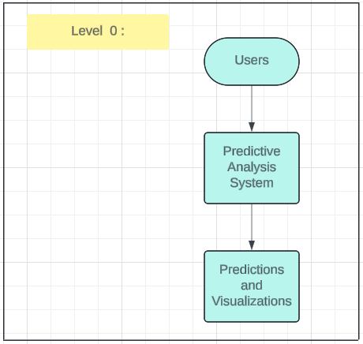
Work Flow Diagram

Slide 9
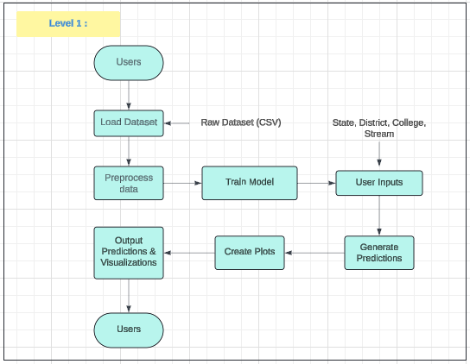
Work Flow Diagram

Slide 10
Work Flow
Users provide the dataset:
Users upload the raw dataset (CSV file) to the system.
Input Data Collection:
Load Dataset: The system loads the raw dataset into memory from the uploaded CSV file.
Preprocess Data: The data is cleaned and prepared for analysis (handling missing values, normalizing data, etc.).
Model Training:
Split Data: The preprocessed data is divided into training and testing sets to validate the model.
Train Model: The system trains a Linear Regression model using the training dataset.

Slide 11
Work Flow
User Inputs:
Provide Inputs: Users input specific state, district, college, and stream details.
Function: These inputs are used to filter the data and tailor the predictions specifically for those details
Prediction:
Generate Predictions: The trained model predicts future joining probabilities based on the given input factors and user-provided details (state, district, college, stream).
Visualization:
Create Plots: The system generates visualizations (graphs or charts) to show how different factors affect the joining probabilities for the specified state, district, college, and stream.
Output Results:
Output Predictions and Visualizations: The final predictions and visualizations are presented to the users to help them make data-driven decisions.

Slide 12
Choosing a Machine Learning Algorithm
For predicting future values based on past data, several algorithms can be used. The choice depends on the complexity and nature of the data:
Linear Regression: For simple, linear relationships between features and target.
Decision Trees and Random Forests: For capturing non-linear relationships and interactions between features.
Neural Networks: For complex and high-dimensional data with intricate patterns.
In our project, a Random Forest Regressor is used because it can handle non-linear relationships and provide robust predictions by averaging multiple decision trees, reducing the risk of overfitting.
By following these steps, the algorithm can effectively learn from past data and make accurate predictions for future outcomes.

Slide 13
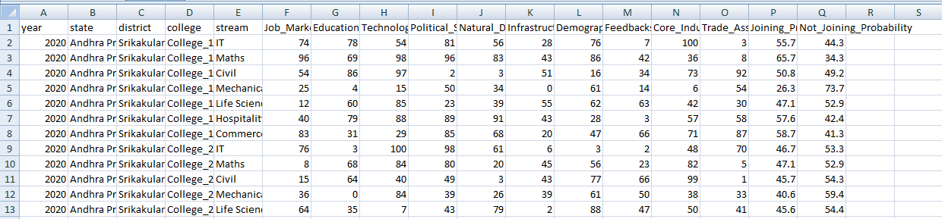
Dataset sample

Slide 14
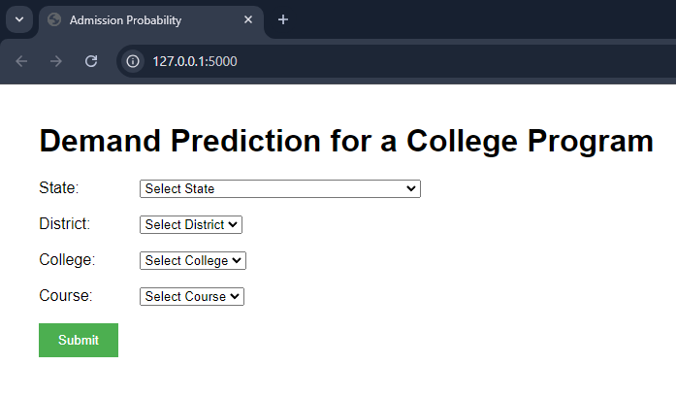
Input Design

Slide 15
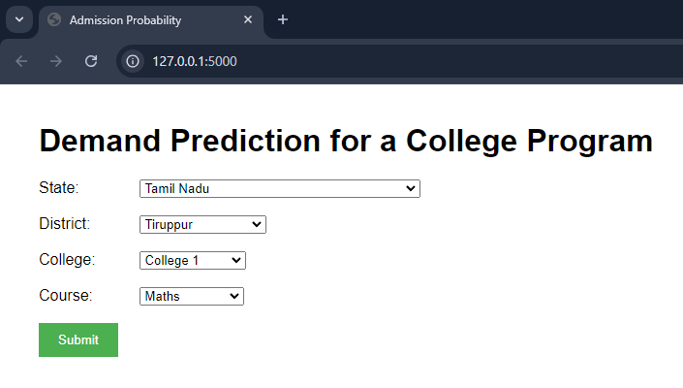
Input Design

Slide 16
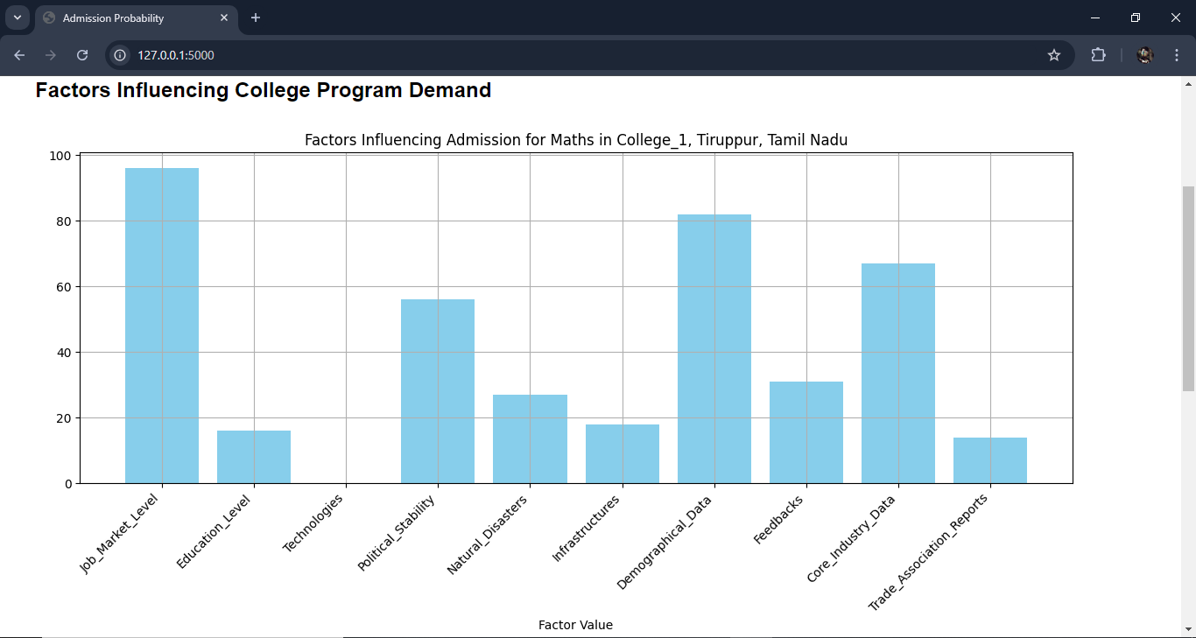
Output Design

Slide 17
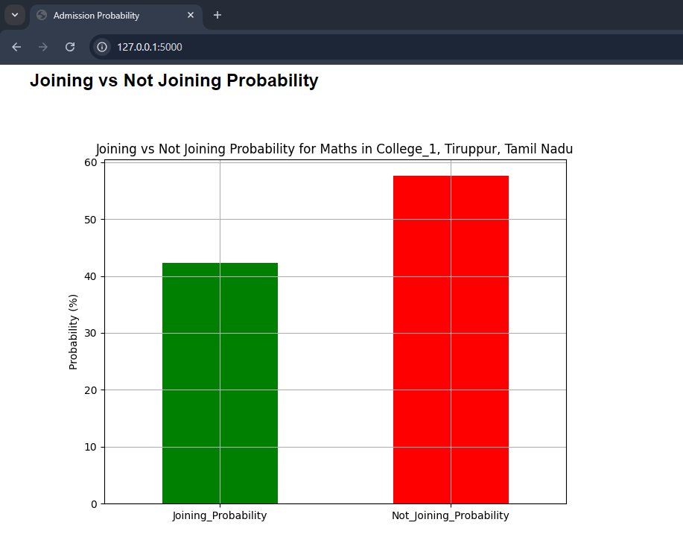
Output Design

Slide 18
Thank You

